Slide 1




MAWHIBA · GRADE 9 · WEEK 8
Unit 2 · Activity 4
Repeated
Linear Functions
Your crew leads. Your teacher facilitates.
Sequences generated by repeated application of a linear function
Mr Malek Thiab
FAITH, RIGHTEOUSNESS AND WISDOM
Notes:
Teacher notes: One 40-minute session, one activity. Crews of four lead; you facilitate with questions and do not explain results. Timings: Task 1 in 10 minutes (0 to 10), Task 2 in 10 (10 to 20), Task 3 in 10 (20 to 30), Apply 5 (30 to 35), Present and record 5 (35 to 40). Hand out the worksheet at the door and make sure each crew can open a spreadsheet or graph plotter (the Guide wants students to choose their own tools). Source: Unit 2 Activity 4, Student Book p.20 and Teachers' Guide pp.34-36. The printed Student Book lost the fraction in the function; it is f(x) = 0.5x + 3, confirmed by the Guide's own sequences.
Worked solution: none needed here.
Verbal misconceptions: students may say 'this is a new topic'. It is not: it is composite functions (Activity 2) used again and again.
Adaptive routing: if fewer than half the crews have a spreadsheet running by minute 3, put one crew's screen on the board and let the others copy the fill-down step.

Slide 2


Your journey
Five stations, 40 minutes, ending with the Mawhiba record. Each one zooms in as you arrive.
Graph it
10 min
Apply
5 min
2
4
1
3
5
Start at 1
10 min
Investigate
10 min
Present
5 min
FAITH, RIGHTEOUSNESS AND WISDOM
Notes:
Teacher notes: Show the map and let a student read the five stations aloud. Stations 1 to 3 are Tasks 1 to 3 of the worksheet, Station 4 is the nursery model, Station 5 is the Mawhiba record. In slideshow mode the Morph transition animates the circles into the breadcrumb; without Morph the slides fade.
Worked solution: none.
Verbal misconceptions: none expected at this point.
Adaptive routing: if the class has met all of Activities 1 to 3, skip the recap of ff(x) meaning 'apply twice' and go straight to Station 1.

Slide 3
What this activity is for
UNIT 2 LEARNING OBJECTIVES
ADVANCED PERFORMANCE CHARACTERISTICS
Identify the properties of linear functions and their graphs, including composite and inverse functions
Use geometrical and algebraic reasoning to express generalisations and prove results
Reason with algebra and make links with geometrical representations
Appreciate the importance of mathematical explanation and proof
MAWHIBA GRADE 9 · WEEK 8 · UNIT 2 · ACTIVITY 4
FAITH, RIGHTEOUSNESS AND WISDOM
Mr Malek Thiab · 3
Notes:
Teacher notes: Left card is the Unit 2 learning objectives and right card is the Advanced performance characteristics the Guide lists for this activity, both quoted from the books. Let a student read each aloud. At the end crews say what they did for each.
Worked solution: none.
Verbal misconceptions: 'proof' sounds like something only for geometry. Say that an explanation that works for every start value is the proof here.
Adaptive routing: none at this slide.

Slide 4
How this session works: the Crew model
GRAPHER
ALGEBRAIST
STUCK LADDER
Re-read the task.
Ask your crew.
Ask another crew.
Ask your teacher last.
Plots the graphs and checks every point is accurate.
Simplifies the functions and writes the algebra clearly.
CHECKER
REPORTER
CREW RULES
Everyone draws.
Everyone explains.
Roles rotate at every task.
Crew first, teacher last.
Tests every idea on a new example and asks: how do we know?
Records the crew findings and presents them to the class.
MAWHIBA GRADE 9 · WEEK 8 · UNIT 2 · ACTIVITY 4
FAITH, RIGHTEOUSNESS AND WISDOM
Mr Malek Thiab · 4
Notes:
Teacher notes: Form crews of 4 before the session. Roles rotate at every task. The teacher answers only after the crew has used the stuck ladder. The six Mawhiba values (inquiry, risk taking, creativity, perseverance, collaboration, concern for society) are recorded on the last station.
Worked solution: none.
Verbal misconceptions: 'Grapher only draws, Algebraist only calculates'. Roles rotate so everyone does both.
Adaptive routing: if a crew has three students, the Checker also acts as Reporter.

Slide 5
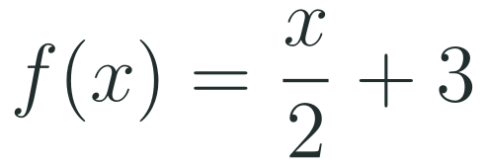
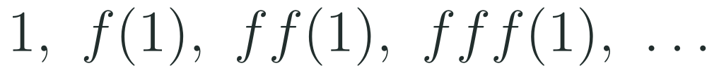




1
2
3
4
5
STATION 1 · START AT 1 · 10 MIN
Task 1: start at 1 and keep applying the function
THE FUNCTION
DO THIS NOW
Open a spreadsheet.
Type the start value in the first cell.
In the next cell apply the rule to the cell above. Fill down.
Apply the function, then apply it to the answer, and keep going. Each output becomes the next input.
EVERYONE
PAIR 1
PAIR 2
YOUR CHOICE
DONE WHEN
You have at least eight terms for each start value, and you can say what the terms are getting close to, and from which side.
MAWHIBA GRADE 9 · WEEK 8 · UNIT 2 · ACTIVITY 4
FAITH, RIGHTEOUSNESS AND WISDOM
Mr Malek Thiab · 5
Notes:
Teacher notes (minutes 0 to 10; checkpoint minute 10). The function is f(x) = 0.5x + 3. Spreadsheet: type the start in A1, type the rule using A1 in A2, fill down. The Guide: 'They will notice that the sequence tends towards the value 6, from below or above. They should also note that when x = 6, f(x) = 6, so that all terms in the sequence are 6.'
Worked solution (exact, checked): start 1: 1, 3.5, 4.75, 5.375, 5.6875, 5.84375, 5.921875, 5.9609375, 5.98046875. Start 2: 2, 4, 5, 5.5, 5.75, 5.875, 5.9375, 5.96875, 5.984375. Start 9: 9, 7.5, 6.75, 6.375, 6.1875, 6.09375, 6.046875, 6.0234375, 6.01171875. Start 6: 6, 6, 6, 6, 6, 6, 6, 6, 6. Every step halves the distance to 6: from 1 the gaps are 5, 2.5, 1.25, 0.625; from 9 the gaps are 3, 1.5, 0.75, 0.375. The terms never reach 6 exactly, but get as close as you like.
Verbal misconceptions: (1) 'ff(1) means f(1) times f(1)' or '2 times f(1)': it means apply f to the answer f(1). (2) 'The sequence goes up because we keep adding 3': from 9 it goes DOWN, the 0.5 shrinks it. (3) 'Different starts give different limits': all give 6.
Adaptive routing: if more than a third of crews cannot produce term 3 for start 1 by minute 4, show the fill-down step for one minute. If a crew finishes by minute 6, send it to Investigate: try start 6, start -10 and start 100 and compare how fast each settles.

Slide 6
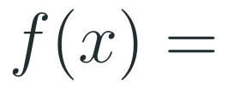
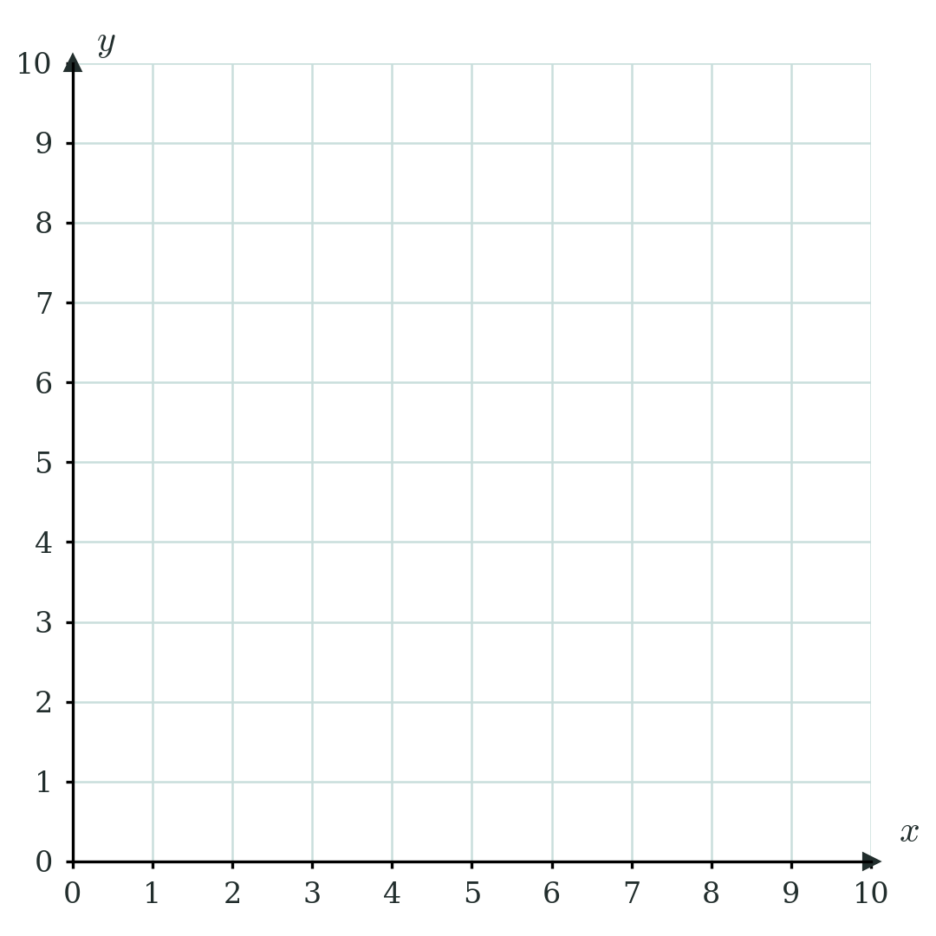
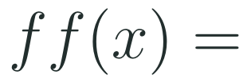
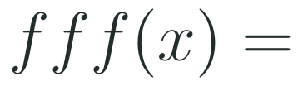
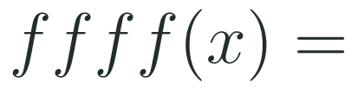

1
2
3
4
5
STATION 2 · GRAPH IT · 10 MIN
Task 2: apply it again, then simplify
YOUR GRID
THINK ABOUT IT
Plot all four graphs on one set of axes.
What do you notice about these functions?
Why does the solution of
give the limit?
Use a ruler. Label every line.
MAWHIBA GRADE 9 · WEEK 8 · UNIT 2 · ACTIVITY 4
FAITH, RIGHTEOUSNESS AND WISDOM
Mr Malek Thiab · 6
Notes:
Teacher notes (minutes 10 to 20; checkpoint minute 20 for the graph). Task: 'Write down and simplify expressions for the functions f(x), ff(x), fff(x) and ffff(x). Plot their graphs on one set of axes.'
Worked solution: f(x) = 0.5x + 3. ff(x) = 0.5(0.5x + 3) + 3 = 0.25x + 4.5. fff(x) = 0.5(0.25x + 4.5) + 3 = 0.125x + 5.25. ffff(x) = 0.5(0.125x + 5.25) + 3 = 0.0625x + 5.625 (the Guide prints 5.625; its text layer cuts it to '625'). Each line can be written y - 6 = 0.5(x - 6), y - 6 = 0.25(x - 6), y - 6 = 0.125(x - 6), y - 6 = 0.0625(x - 6): all pass through (6, 6) with a gradient that halves each time. The limiting case is the horizontal line y = 6. Why f(x) = x gives the limit: the limit L must satisfy f(L) = L, because applying f to a value that is already the limit changes nothing. 0.5x + 3 = x gives x = 6. On the graph, (6, 6) is where y = f(x) meets y = x.
Verbal misconceptions: (1) ff(x) = (0.5x + 3)(0.5x + 3) or 0.25x + 3: the 3 inside must also be halved (0.5 times 3 is 1.5, plus 3 is 4.5). (2) 'The graphs are parallel': the gradients are 0.5, 0.25, 0.125, 0.0625, so they are not. (3) 'f(x) = x is a graph': it is an equation we solve to find where the two graphs cross.
Adaptive routing: if more than 30 percent of crews write ff(x) = 0.25x + 3, pause and have the Checker substitute x = 2: f(2) = 4, ff(2) = 5, and 0.25(2) + 3 = 3.5 does not match, while 0.25(2) + 4.5 = 5 does. Crews who finish early plot y = x and mark (6, 6).

Slide 7
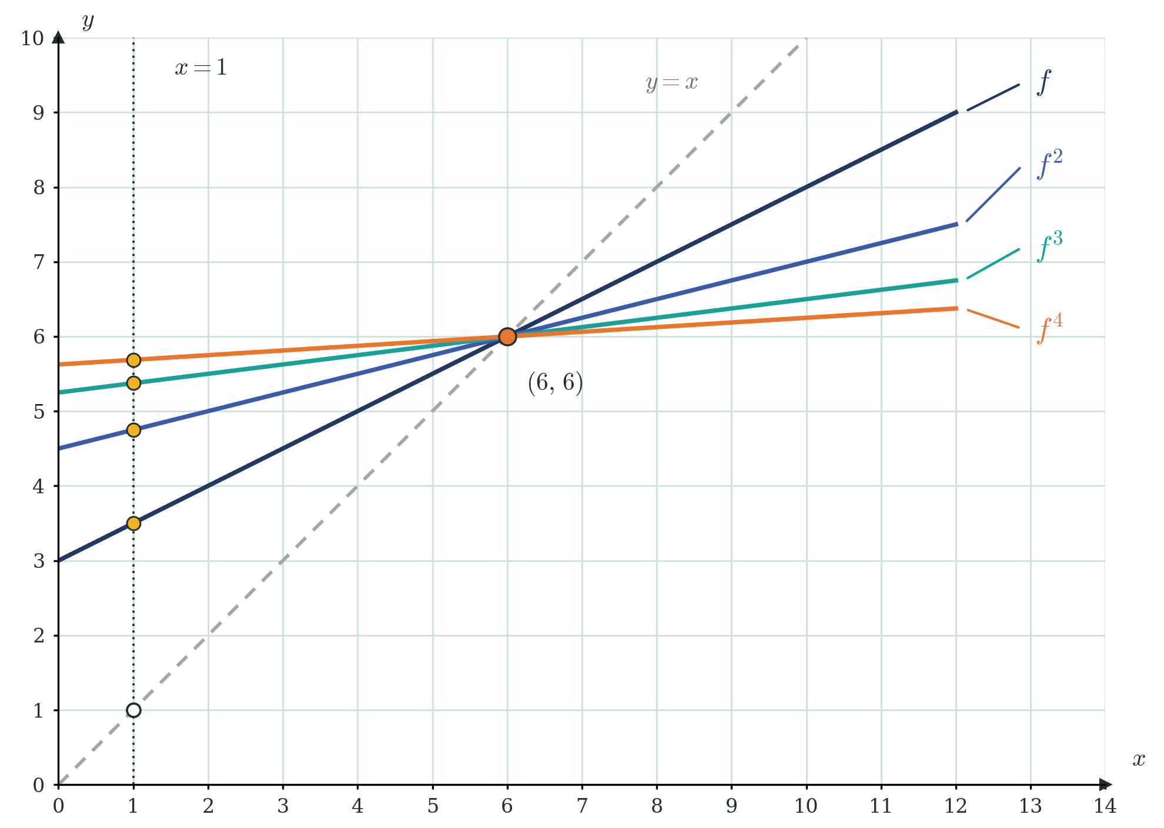
1
2
3
4
5
STATION 2 · GRAPH IT · 10 MIN
Check your picture
COMPARE WITH YOUR GRAPH
Do your four lines meet at one point? Which point?
What happens to the steepness each time the function is applied again?
The gold dots sit on the dotted vertical line. Where have you seen those numbers before?
Which line is the limiting case?
MAWHIBA GRADE 9 · WEEK 8 · UNIT 2 · ACTIVITY 4
FAITH, RIGHTEOUSNESS AND WISDOM
Mr Malek Thiab · 7
Notes:
Teacher notes (self-check, minutes 18 to 20). Reveal after crews have their own graphs; ask them to compare, not copy. The figure shows y = f(x), ff(x), fff(x), ffff(x), the dashed line y = x and (6, 6). The gold dots on the vertical dotted line through 1 are the Task 1 terms: f(1) = 3.5, ff(1) = 4.75, fff(1) = 5.375, ffff(1) = 5.6875. The white dot is the start value 1 on y = x. The Guide: 'Points of intersection with the line x = 1 represent values of the terms in the sequence, first calculated in task 1.'
Worked solution: read upward along x = 1 to each line in turn and compare with the spreadsheet column.
Verbal misconceptions: 'ffff is almost flat so it equals 6': no finite number of steps reaches y = 6; the horizontal line is the limiting case. 'The graphs cross y = x at different places': they all cross it at (6, 6).
Adaptive routing: if a crew's lines do not meet at one point, send them back to the algebra for the line that is off; the Checker tests that line at x = 6, where every one of these functions must give 6.

Slide 8
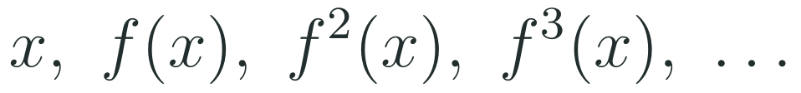
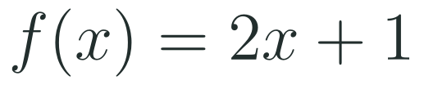
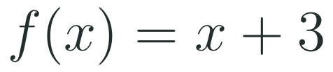
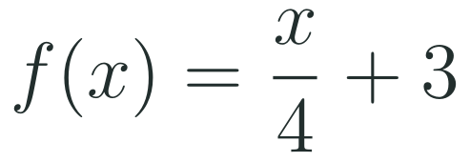
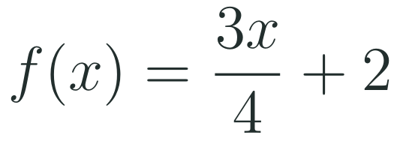
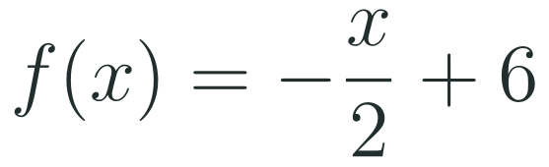
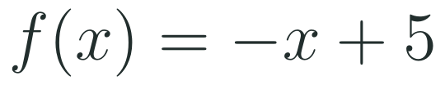
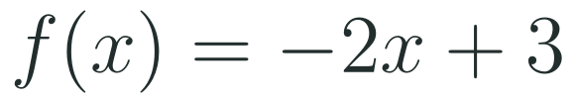
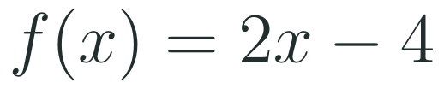
1
2
3
4
5
STATION 3 · INVESTIGATE · 10 MIN
Task 3: other linear functions
In shorthand we write:
A
B
C
D
E
F
G
H
FOR EACH CARD
WHAT DO YOU NOTICE?
Find the value that the function maps onto itself, if there is one.
Choose a start value and list at least six terms.
Describe what the terms do.
Each crew member takes two cards. Sort all eight into families. What decides the family: the gradient, the intercept, or both? Explain any general results you find.
MAWHIBA GRADE 9 · WEEK 8 · UNIT 2 · ACTIVITY 4
FAITH, RIGHTEOUSNESS AND WISDOM
Mr Malek Thiab · 8
Notes:
Teacher notes (minutes 20 to 27). Task: 'Investigate the sequence x, f(x), f²(x), f³(x), ... for other linear functions. Explain any general results that you find.' Each crew member takes two cards; the Guide suggests a group of three or four, each exploring one or two functions, then pooling. The eight cards cover every case.
Worked solution (one sample start each; students may choose others): A: f(x) = 2x + 1, start 1: 1, 3, 7, 15, 31, 63, 127; fixed value -1; moves away from the fixed value, getting faster | B: f(x) = x + 3, start 1: 1, 4, 7, 10, 13, 16, 19; no fixed value (c is not 0); arithmetic sequence, common difference 3 | C: f(x) = 0.25x + 3, start 8: 8, 5, 4.25, 4.0625, 4.015625, 4.00390625, 4.0009765625; fixed value 4; settles on the fixed value | D: f(x) = 0.75x + 2, start 4: 4, 5, 5.75, 6.3125, 6.734375, 7.05078125, 7.2880859375; fixed value 8; settles on the fixed value | E: f(x) = -0.5x + 6, start 2: 2, 5, 3.5, 4.25, 3.875, 4.0625, 3.96875; fixed value 4; settles on the fixed value | F: f(x) = -x + 5, start 1: 1, 4, 1, 4, 1, 4, 1; fixed value 2.5; repeats two values forever | G: f(x) = -2x + 3, start 2: 2, -1, 5, -7, 17, -31, 65; fixed value 1; jumps from side to side, further out each time | H: f(x) = 2x - 4, start 5: 5, 6, 8, 12, 20, 36, 68; fixed value 4; moves away from the fixed value, getting faster. Guide's results for f(x) = mx + c: if m > 1 the sequence increases in a non-linear way; if m = 1 it is an arithmetic sequence with common difference c; if m < 1 it converges to the value given by mx + c = x, that is c divided by (1 - m). What students will find beyond the Guide's three lines: the Guide's 'm < 1' only holds when m is greater than -1. Card F (m = -1) repeats two values; card G (m less than -1) alternates and grows. Also m > 1 only increases if the start is above the fixed value: card H from 3 gives 2, 0, -4, -12 (moves away downward), and from 4 stays at 4. This is a correction to widen the Guide, flagged for you.
Verbal misconceptions: (1) 'Negative gradient means it goes down': it jumps either side of the fixed value. (2) 'No limit means nothing happens': card F cycles, card G explodes. (3) 'Every linear function has a fixed value': card B (m = 1, c not 0) has none.
Adaptive routing: if after 5 minutes crews have only sorted by 'goes up or down', ask which cards settle and which do not, then what is the same about their gradients. If a crew finishes both cards early, hand them the next letter in the alphabet.

Slide 9
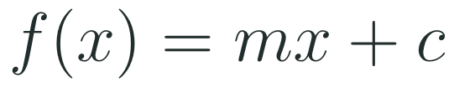
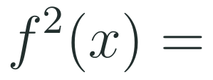
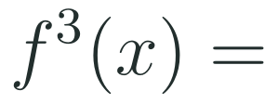
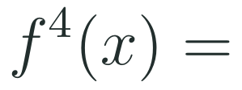
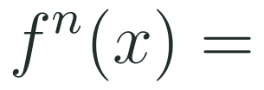
1
2
3
4
5
STATION 3 · INVESTIGATE · 10 MIN
Task 3: explain with algebra
Take a general linear function
TRY THIS
Apply the rule to its own output and expand.
Look for the pattern in the power of the gradient and in the constant term.
Test your formula on two of your cards.
EXPLAIN
Use your formula to explain what happens to the terms when the gradient is large, small or negative.
Done by minute 30.
MAWHIBA GRADE 9 · WEEK 8 · UNIT 2 · ACTIVITY 4
FAITH, RIGHTEOUSNESS AND WISDOM
Mr Malek Thiab · 9
Notes:
Teacher notes (minutes 27 to 30). The Guide suggests exploring the general form of the function rather than generalising from particular cases (this is the Investigate route). It is for crews that already have a pattern from the cards.
Worked solution: f(x) = mx + c. f²(x) = m(mx + c) + c = m²x + (1 + m)c. f³(x) = m(m²x + (1 + m)c) + c = m³x + (1 + m + m²)c. f⁴(x) = m⁴x + (1 + m + m² + m³)c. In general fⁿ(x) = mⁿ x + (1 + m + m² + ... + mⁿ⁻¹)c. If |m| < 1 then mⁿ tends to 0 as n grows, so the terms approach (1 + m + m² + ...)c. The Guide: 'It may be beyond students' current level of knowledge that the bracketed expression is a geometric series... The teacher will need to judge whether it would be appropriate to discuss this series.' Its sum is 1 divided by (1 - m), giving c divided by (1 - m), the same fixed value found from mx + c = x. Check with the function from Task 1 (m = 0.5, c = 3): f²(x) = 0.25x + 4.5, matching Task 2. Equivalent compact form: fⁿ(x) = mⁿ (x - p) + p where p = c divided by (1 - m); for card D (m = 0.75, p = 8) start 4 gives 8 - 4(0.75)ⁿ, so the gap to 8 shrinks by 0.75 each time.
Verbal misconceptions: (1) f²(x) = (mx + c)2 or m²x + c: the second application multiplies c by m again. (2) 'The pattern in c is just c, 2c, 3c': that is only true when m = 1. (3) Students write mⁿ x + c(1 + m + ... ) without noticing the brackets are a sum of n terms.
Adaptive routing: if a crew cannot expand f² after 2 minutes, give the line 'put mx + c in place of x in mx + c'. If a crew finishes, ask what changes if the start value is exactly the fixed value, and prove it with their formula.

Slide 10
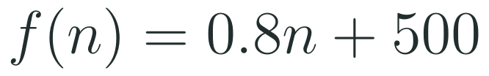
1
2
3
4
5
STATION 4 · APPLY · 5 MIN
Apply: a Jeddah tree nursery
MODEL VALUES
THINK
A Jeddah nursery grows saplings for tree-planting projects in the spirit of the Saudi Green Initiative. Each year 20% of its saplings are lost and 500 new ones are planted.
What does the fraction kept each year tell you about the gradient?
Does the long-run number change if it starts above or below it?
These numbers are illustrative model values, not real nursery data.
It starts with 1000 saplings. How many after 1, 2 and 3 years?
In the long run, how many saplings will it hold? Use your Task 2 idea.
What if only 10% were lost each year? Predict first, then check.
MAWHIBA GRADE 9 · WEEK 8 · UNIT 2 · ACTIVITY 4
FAITH, RIGHTEOUSNESS AND WISDOM
Mr Malek Thiab · 10
Notes:
Teacher notes (minutes 30 to 35). Model values: the figures (20 percent lost each year, 500 planted, 1000 to start) are illustrative and not real nursery data; the context is inspired by tree-planting under the Saudi Green Initiative. f(n) = 0.8n + 500, where n is the number of saplings now and f(n) the number next year.
Worked solution: from 1000: 1000, 1300, 1540, 1732 after 1, 2 and 3 years (1300 = 0.8 times 1000 + 500; 1540 = 0.8 times 1300 + 500; 1732 = 0.8 times 1540 + 500). Long run: solve 0.8n + 500 = n, so 500 = 0.2n and n = 2500; from below the numbers rise towards 2500, from above they fall: from 4000 the next terms are 3700, 3460, 3268. With 10 percent lost: f(n) = 0.9n + 500, long run 500 divided by 0.1 = 5000; from 1000 the next terms are 1400, 1760, 2084. Predicting 5000 uses the Task 3 result c divided by (1 - m).
Verbal misconceptions: (1) '20 percent lost means multiply by 0.2': 80 percent are kept so the gradient is 0.8. (2) 'The nursery will keep growing because 500 are added every year': the loss grows with the stock until it balances the 500 (0.2 times 2500 = 500). (3) 'A bigger start gives a bigger long-run number': the long-run number does not depend on the start.
Adaptive routing: if crews are slow on question 1, show that each year is one more application of f. If crews finish, ask which loss rate would make the long run 10000 (5 percent: 500 divided by 0.05 = 10000).

Slide 11
1
2
3
4
5
STATION 5 · PRESENT · 5 MIN
Present and record
CREW REPORT · 1 MINUTE
MY MAWHIBA RECORD
Two Reporters each show one result: one from Task 2 and one from Task 3 or the nursery.
Give the evidence: your table, your graph or your algebra.
Another crew asks one question. The Checker answers.
Tick the value you showed today and write one example.
Inquiry
Risk taking
example: ...........
example: ...........
Creativity
Perseverance
example: ...........
example: ...........
Collaboration
Concern for society
Everyone in the crew can answer for the whole crew.
example: ...........
example: ...........
MAWHIBA GRADE 9 · WEEK 8 · UNIT 2 · ACTIVITY 4
FAITH, RIGHTEOUSNESS AND WISDOM
Mr Malek Thiab · 11
Notes:
Teacher notes (minutes 35 to 40). One crew Reporter shows a result from Task 2 and one from Task 3 or the nursery, 1 minute each. Another crew asks one question; the Checker answers. Everyone then ticks the Mawhiba value they showed and writes one example; students keep the record with their cumulative Mawhiba record.
Worked solution: model answers to listen for: 'the terms close in on 6 because each step halves the distance'; 'the limit solves f(x) = x'; 'when the gradient is between -1 and 1 the terms settle, otherwise they do not'.
Verbal misconceptions: crews may report a table without explaining it. Prompt: 'Why does that happen?'
Adaptive routing: if time is short, cut the second report and keep the record.

Slide 12
1
2
3
4
5
STATION 5 · PRESENT · 5 MIN
Done when: check your own work
TASK 1
TASK 2
Three start values are tabulated, and you can say what the terms get close to and from which side.
You can explain, using your graphs, why the value that the function maps onto itself is the limiting value.
TASK 3
APPLY
You can describe the different behaviours you found, with evidence from at least two cards, and test a formula.
You can find the long-run number in the nursery model and say why it does not depend on the start.
MAWHIBA GRADE 9 · WEEK 8 · UNIT 2 · ACTIVITY 4
FAITH, RIGHTEOUSNESS AND WISDOM
Mr Malek Thiab · 12
Notes:
Teacher notes: Four checks, one per task. Students tick each when they can show evidence. Task 1: three tables and the number 6 reached from both sides. Task 2: simplified functions, the graph and the explanation that f(6) = 6. Task 3: sorted cards and a tested formula. Apply: 2500 and why the start does not matter.
Worked solution: see the notes on the Task 1 to Apply slides.
Verbal misconceptions: a tick without evidence. Ask each student to point to the line in their work that proves it.
Adaptive routing: any crew with an unticked box takes that task home as the first item of next week's session.

Slide 13
Journey complete
Graph it
Apply
✓
✓
✓
✓
✓
Start at 1
Investigate
Present
You found it yourselves: keep applying the function and the terms settle where it maps a number onto itself.
FAITH, RIGHTEOUSNESS AND WISDOM
Notes:
Teacher notes: Close with the one idea: keep applying a linear function and the terms head for the value the function maps onto itself, provided the gradient lies between -1 and 1. Next session continues Unit 3.
Worked solution: for f(x) = 0.5x + 3 the limit is 6, from 0.5x + 3 = x.
Verbal misconceptions: 'every sequence settles'. Only gradients strictly between -1 and 1.
Adaptive routing: collect worksheets from crews that did not finish; they continue next week.

